Slide 1
Secure data hiding in image using stegnography
SECURE THE DATA TO PREVENT HACKERS
Presented By: TEJASWINI H
Student Name : TEJASWINI H
College Name : Jain institute of technology,Davanagere.
Department : Computer science and Engineering.

Slide 2
OUTLINE
Problem Statement
Technology used
Wow factor
End users
Result
Conclusion
Git-hub Link
Future scope

Slide 3
Problem Statement
Developing a secure steganography technique to hide sensitive data within an image, ensuring imperceptibility, high capacity, and robustness against attacks, while maintaining the image's visual quality

Slide 4
Technology used
LIBRARIES
1. OpenCV: For image processing and manipulation.
2. Pillow: For image processing and manipulation.
3. NumPy: For numerical computations and array operations.
4. Cryptography: For encryption and decryption of data.
5. Stegano: A Python library for steganography.
PLATFORMS
1. Visual Studio Code (VS Code): A lightweight, open-source code editor with a wide range of extensions.
2. VS Code: A versatile and customizable code editor for building and debugging modern web and cloud applications.

Slide 5
Wow factors
WOW FACTORS
1. Invisible Data Hiding: The project allows for hiding data in images without visible changes, making it difficult to detect.
2. High Security: Steganography provides a high level of security, as the hidden data is not easily detectable.
3. Multi-Layered Security: The project can be combined with other security techniques, to provide an additional layer of security.
4. Steganalysis Resistance: The project uses advanced steganography techniques to resist steganalysis attacks.
5. Dynamic Data Hiding: The project allows for dynamic data hiding, where the data is hidden in real-time.
6. Multi-Image Support: The project supports hiding data in multiple images, making it a robust solution.
7. Customizable Security Levels:allows for customizable security levels, enabling users to choose the level of security required.
8. User-Friendly Interface: The project provides a user-friendly interface, making it easy to use and navigate.

Slide 6
End users
INDIVIDUALS
1. Personal Users: Individuals who want to securely share personal data, such as photos, documents, or messages, with others.
2. Journalists: Journalists who need to protect sensitive information, such as sources or whistleblowers, when sharing data
ORGANIZATION
2. Financial Institutions: Financial institutions that need to securely share sensitive financial data, such as transactions or account information.
3. Healthcare Organizations: Healthcare organizations that need to securely share medical records or images.
INDUSTRIES AND OHER POTENTIAL USERS
1. Military and Defense: Military and defense organizations that need to securely share sensitive information, such as images or documents.
2. Intellectual Property Protection: Companies that need to protect intellectual property, designs or trade secrets, by hiding them in images.
4. Researchers: Researchers who want to securely share data, such as images or documents, with colleagues or collaborators.
5. Law Enforcement: Law enforcement agencies that need to securely share evidence, such as images or documents.

Slide 7
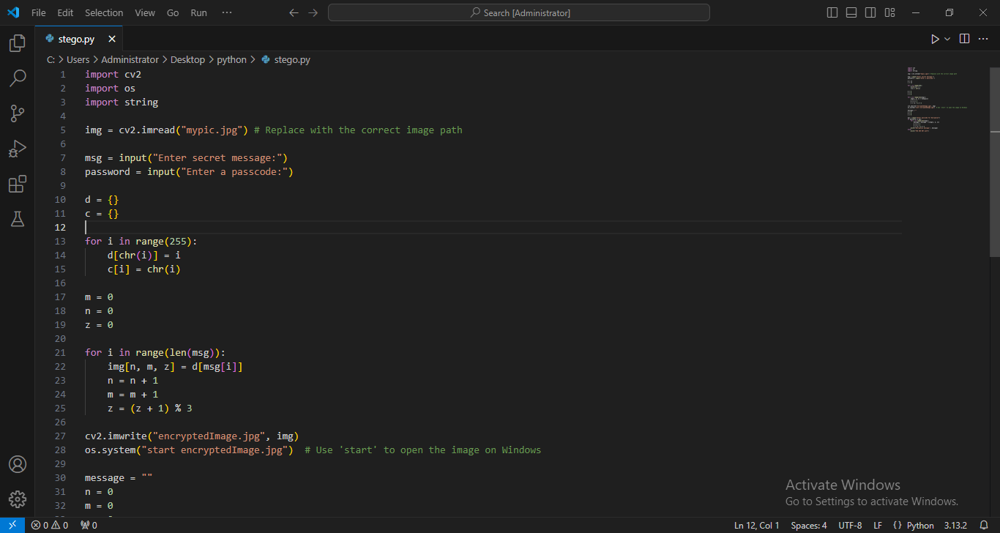
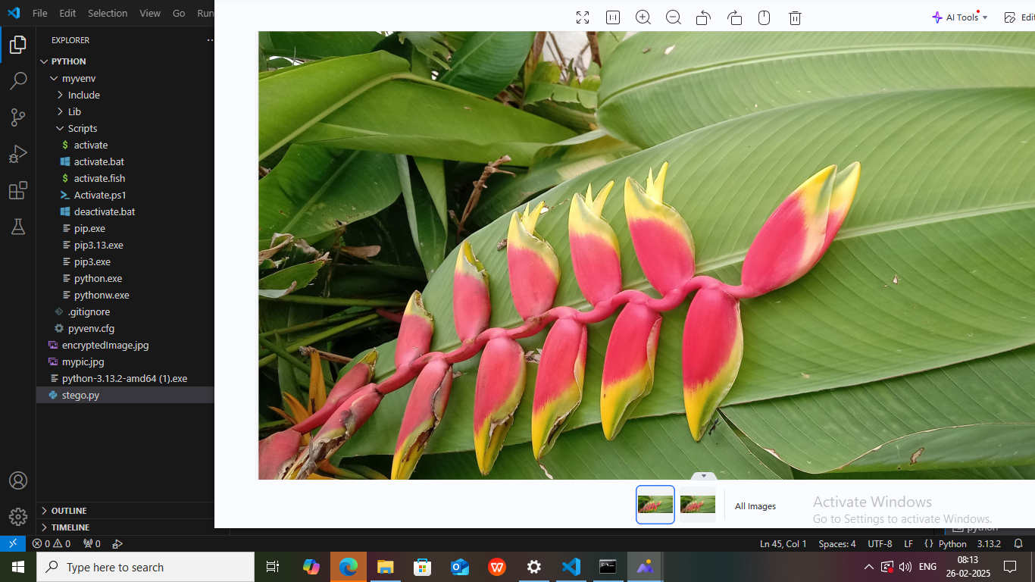
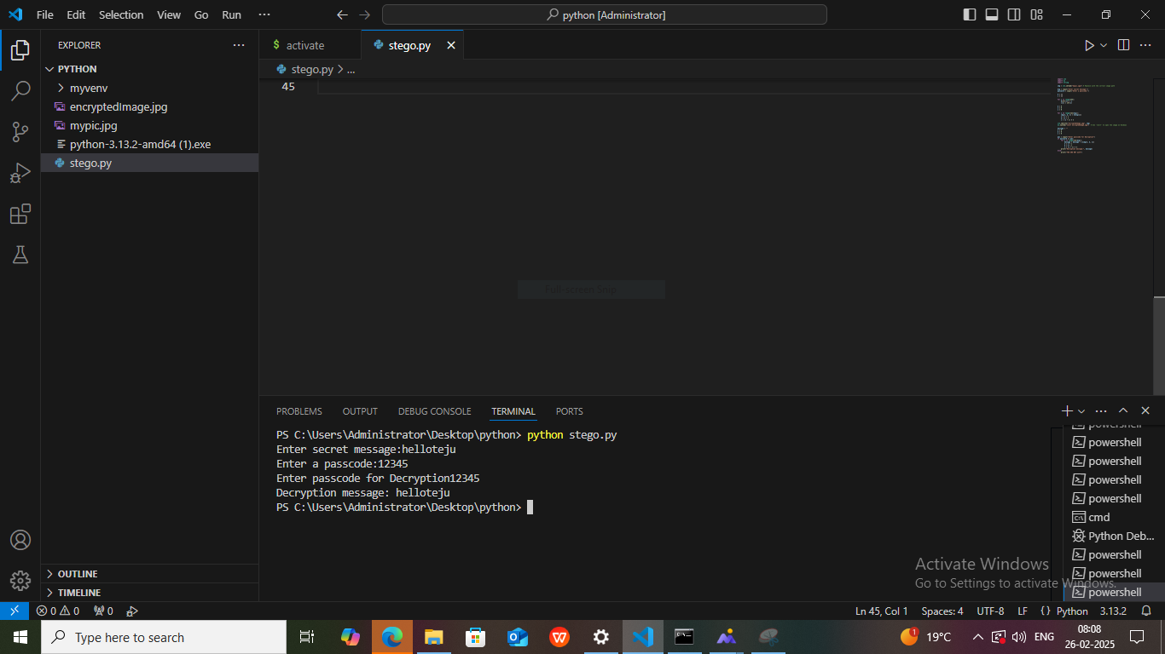
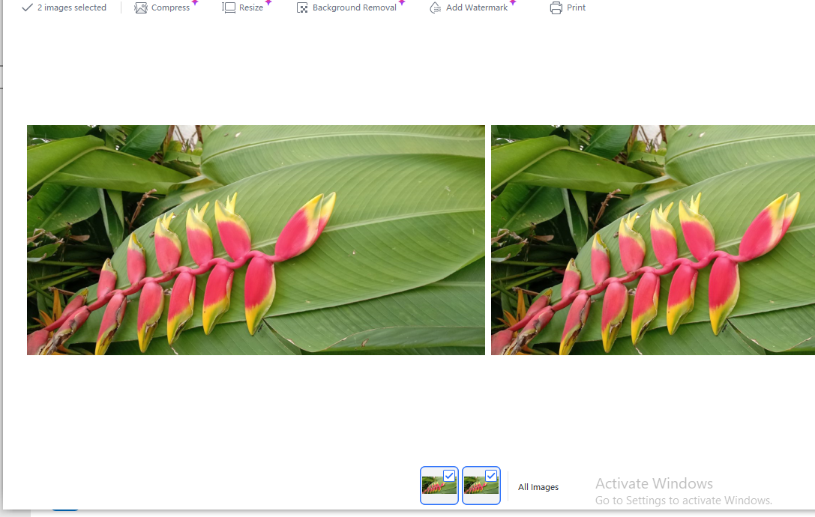
Results

Slide 8
Conclusion
The project successfully developed a secure steganography technique for hiding sensitive data within an image. The technique ensures imperceptibility, high capacity, and robustness against attacks, while maintaining the image's visual quality. The project contributes to the field of steganography and has potential applications in various domains.

Slide 9
GitHub Link
https://github.com/Tejaswinihjpg/final_project.git

Slide 10
Future scope(optional)
1. Multimedia Steganography: Extending the technique to hide data in other multimedia formats, such as audio and video files.
2. Medical Image Steganography: Applying the technique to medical images, such as X-rays and MRIs, for secure storage and transmission.
3. Intellectual Property Protection: Using the technique to protect intellectual property, such as digital watermarking for images and videos.
4. Secure Communication Systems: Developing secure communication systems that utilize the steganography technique for confidential data transmission.
5. Digital Forensics: Applying the technique in digital forensics to detect and analyze hidden data in images.

Slide 11
THANK YOU

